Slide 1
The Daily 5
You will become an AMAZING READER

Slide 2
Read to Self
This is how we do it….
1. Shop for a book. ( I pick)
2. Find a comfortable spot in the room to read your book. You should not be close to anyone else.
3. Read inside your head…not out loud.

Slide 3
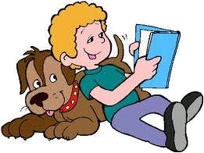
Good Fit Books
I-LOOK AT THE BOOK & choose one
P-PURPOSE
Why do I want to read the book?
I-interest
Does it interest me?
C-Comprehend
Am I understanding what I read?
K-Know all the words
Do I know most of the words?

Slide 4
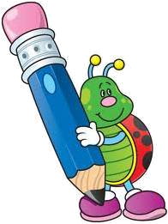
Writing Work
1. Choose a writing activity.
2. If you finish you may choose another
writing activity.
3. Sit a table by yourself to complete your activity.
4. There is no reason to talk unless you need to whisper a question to someone.

Slide 5
Read to Someone
Find a partner and choose a book to read together.
EEKK (elbow to elbow or knee to knee)
3. Sit away from other kids.
4. Read in a low voice.

Slide 6
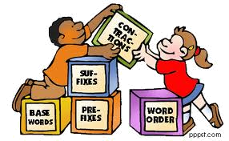
Word Work
1. Choose a word work activity.
2. You may work alone or with a partner.
3. Find your own space in the classroom.
4. You will probably need to talk , however you should be using an “inside” voice.

Slide 7
Listening to Someone
Go to the computers relax and listen to someone read to you.
There should not be any talking, you are just
LISTENING to a good reader.

