Slide 1
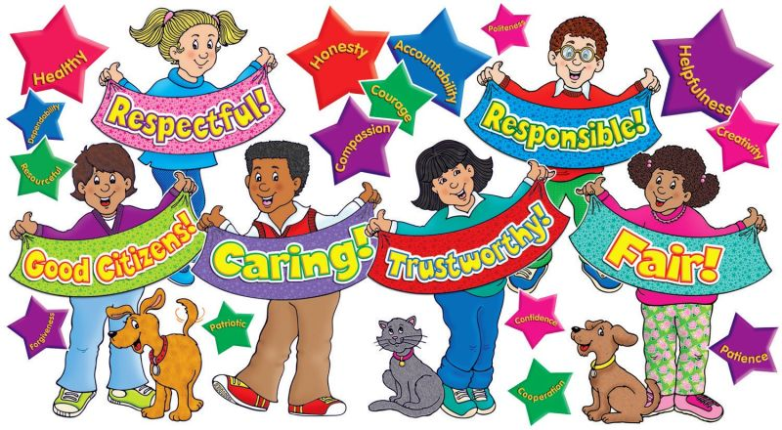
Character Counts

Slide 2
TRUSTWORTHINESS
Be honest
Don’t cheat, or steal
Be reliable
Do what you say you will do
Have courage to do the right thing
Honesty
Courage
Reliability

Slide 3
Respect
Treat others with respect
Use good manners
Don’t hit or hurt anyone
Accept differences
Respect
Good manners
Differences are ok

Slide 4
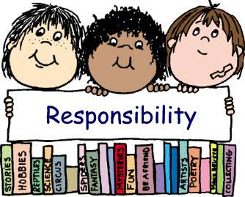
Responsibility
Plan ahead
Think you before you act
Be accountable
Set a good example
Use self-control
Do Your Best
Consider Consequences
Keep Trying

Slide 5
Fairness
Play by the rules
Take turns
Share
Listen to others
Treat all people fairly
Treat ALL people fairly
Share
Take Turns

Slide 6
Caring
Be kind
Share
Be open-minded
Listen to others
Don’t blame others
Don’t take advantage of others
Be kind
Listen to others
Share

Slide 7
Citizenship
Do your share to make your school and community better
Be a good neighbor
Be a good classmate
Obey laws
Protect your environment
Volunteer
Do Your Best
Consider Consequences
Keep Trying

